Slide 1
LEI 21-22 S4 2DC_3​
PROGRESS – SPRINT D
29 MAY 2022
Bárbara Pinto 1191507 | ​Carlos Dias 1200991​ | Cristóvão Sampaio 1201029 | ​ Miguel Silva 1201045​ | Martim Maciel 1201154

Slide 2
SUMMARY – Project Phases
WEEK 1
Technical Review Implementation
Project Review
WEEK 2
Updating Server communications to support secured connections
Development of questionnaire related User Stories
WEEK 3
Development of components/parts of Digital Twin
Development of remaining functionalities

Slide 3
PLANNING - PROJECT
1

Slide 4
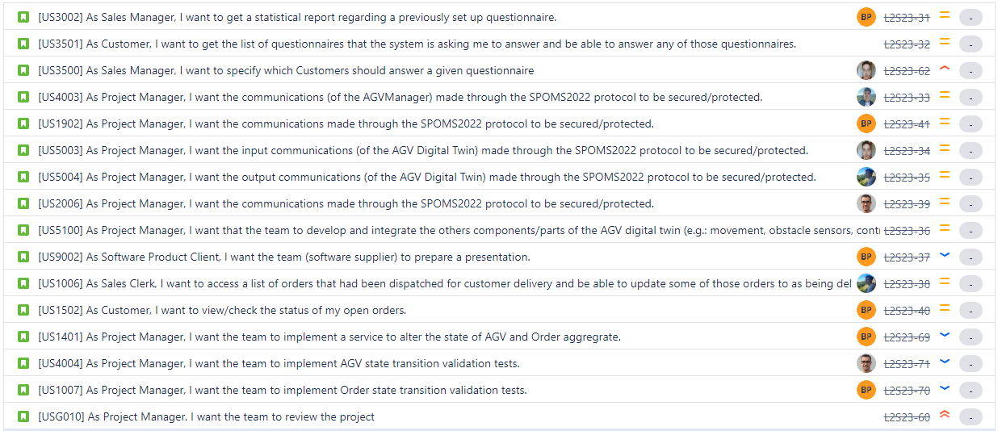

Slide 5
SELF-ASSESSMENT
Name | Technical Skills |  | Behaviour Skills
 | Before | After | Before | After
Bárbara Pinto | Fair | Very Good | Very Good | Very Good
Carlos Dias | Very Good | Very Good | Very Good | Weak
Cristóvão Sampaio | Fair | Very Good | Fair | Good
Miguel Silva | Fair | Very Good | Fair | Good
Martim Maciel | Fair | Fair | Very Good | Very Good
Scale: Very Weak; Weak; Fair; Good; Very Good, Excellent

Slide 6
CONCLUDED ACTIVITIES – PROJECT MANAGEMENT
US​ | Description​ | Assignee​ | Baseline​ | Actual​ | Status​
US4003 | As Project Manager, I want the communications (of the AGVManager) made through the SPOMS2022 protocol to be secured/protected. | Miguel Silva | Start: 5 June 2022 End: 12 June 2022 | Start: 8 June 2022 End: 10 June 2022 | ✔️
US1902 | As Project Manager, I want the communications made through the SPOMS2022 protocol to be secured/protected. | Bárbara Pinto | Start: 5 June 2022 End: 12 June 2022 | Start: 8 June 2022 End: 15 June 2022 | ✔️
US5003 | As Project Manager, I want the input communications (of the AGV Digital Twin) made through the SPOMS2022 protocol to be secured/protected. | Carlos Dias | Start: 5 June 2022 End: 12 June 2022 | Start: 8 June 2022 End: 18 June 2022 | ✔️
US5004 | As Project Manager, I want the output communications (of the AGV Digital Twin) made through the SPOMS2022 protocol to be secured/protected. | Martim Maciel | Start: 5 June 2022 End: 12 June 2022 | Start: 8 June 2022 End: 18 June 2022 | ✔️
US2006 | As Project Manager, I want the communications made through the SPOMS2022 protocol to be secured/protected. | Cristóvão Sampaio | Start: 5 June 2022 End: 12 June 2022 | Start: 8 June 2022 End: 16 June 2022 | ✔️
US1401 | As Project Manager, I want the team to implement a service to alter the state of AGV and Order aggregrate. | Cristóvão Sampaio | Start: ​29 May 2022 End: 5 June 2022 | Start: ​8 June 2022 End: 10 June 2022 | ✔️
 |  | Bárbara Pinto
US4004 | As Project Manager, I want the team to implement AGV state transition validation tests. | Bárbara Pinto | Start: ​29 May 2022 End: 5 June 2022 | Start: ​10 June 2022 End: 10 June 2022 | ✔️
US1007 | As Project Manager, I want the team to implement Order state transition validation tests. | Cristóvão Sampaio | Start: ​29 May 2022 End: 5 June 2022 | Start: ​8 June 2022 End: 9 June 2022 | ✔️

Slide 7
CONCLUDED ACTIVITIES – PROJECT IMPLEMENTATION
US​ | Description​ | Assignee​ | Baseline​ | Actual​ | Status​
US5100 | As Project Manager, I want that the team to develop and integrate the others components/parts of the AGV digital twin (e.g.: movement, obstacle sensors, control unit).
US5100-1 | Route Planner module | Carlos Dias | Start: 12 June 2022 End: 19 June 2022 | Start: 17 June 2022 End: 19 June 2022 | ✔️
US5100-2 | Communications module | Cristóvão Sampaio | Start: 12 June 2022 End: 19 June 2022 | Start: 17 June 2022 End: 19 June 2022 | ✔️
US5100-3 | Simulation Engine/Sensors module | Bárbara Pinto | Start: 12 June 2022 End: 19 June 2022 | Start: 17 June 2022 End: 19 June 2022 | ✔️
US5100-4 | Battery Management System module | Martim Maciel | Start: 12 June 2022 End: 19 June 2022 | Start: 17 June 2022 End: 19 June 2022 | ✔️
US5100-5 | Positioning module | Miguel Silva | Start: 12 June 2022 End: 19 June 2022 | Start: 17 June 2022 End: 19 June 2022 | ✔️
US5100-6 | Control Unit module | Cristóvão Sampaio | Start: 12 June 2022 End: 19 June 2022 | Start: 17 June 2022 End: 19 June 2022 | ✔️

Slide 8
CONCLUDED ACTIVITIES – PROJECT IMPLEMENTATION
US​ | Description​ | Assignee​ | Baseline​ | Actual​ | Status​
US1006 | As Sales Clerk, I want to access a list of orders that had been dispatched for customer delivery and be able to update some of those orders to as being delivered. | Martim Maciel | Start: ​29 May 2022 End: 5 June 2022 | Start: ​31 May 2022 End: 31 May 2022 | ✔️
US1502 | As Customer, I want to view/check the status of my open orders. | Bárbara Pinto | Start: ​29 May 2022 End: 5 June 2022 | Start: ​8 June 2022 End: 8 June 2022 | ✔️
US3501-1 | As Customer, I want to get the list of questionnaires that the system is asking me to answer and be able to answer any of those questionnaires. | Miguel Silva | Start: 5 June 2022 End: 12 June 2022 | Start: 14 June 2022 End: 17 June 2022 | ✔️
US3002 | As Sales Manager, I want to get a statistical report regarding a previously set up questionnaire. | Bárbara Pinto | Start: 5 June 2022 End: 12 June 2022 | Start: 11 June 2022 End: 15 June 2022 | ✔️
US3500 | As Sales Manager, I want to specify which Customers should answer a given questionnaire. | Carlos Dias | Start: 5 June 2022 End: 12 June 2022 | Start: ​9 June 2022 End: 13 June 2022 | ✔️

Slide 9
NOT IMPLEMENTED ACTIVITIES
US​ | Description​ | Assignee​ | Baseline​ | Actual​ | Status​
US3501-2 | As Customer, I want to be able to save my questionnaire answers. | Martim Maciel | Start: ​12 June 2022 End: 19 June 2022 | Start: ​12 June 2022 End: | 🟡

Slide 10
SYSTEM AND PRODUCT DELIVERY
SYSTEM OBJECTIVES
Provide secure protocol communication between application and develop existing functionalities:
» Obtain statistical report for a questionnaire
» Allow a questionnaire to be answeres
» Updated Dispatched orders
» View Status of Open Orders
Guarantee data persistence (in-memory and on a local/online database)​
Provide initialization data to demonstrate system functionalities​
PRODUCT QUALITY
Quality metrics:
» 63% Class coverage ✔️
» 65% Method coverage ✔️
» 64% Class coverage ✔️
Stable build:
» runs outside development environment (IDE)
» runs in remote machines and multiple OS​
Achievements:
» Running servers independently
» Client-server communication implemented with success
​

Slide 11


TEAM WORK AND PLANNING
DEVELOPMENT PROCESS AND PLANNING
» Scrum/Agile methodology​
» JIRA software for task and sprint management​
» Planning based on priority (for time allocation) and user story complexity (for team member allocation)​
TEAM WORK AND CONFLICT SOLVING
» Team daily communication through Discord server and dedicated channels​
» Weekly sprint status reports during LAPR4 PL classes​
» The team considers the sprint was tight on development time but the communication was effective​ and the team members were very cooperative.
​

Slide 12
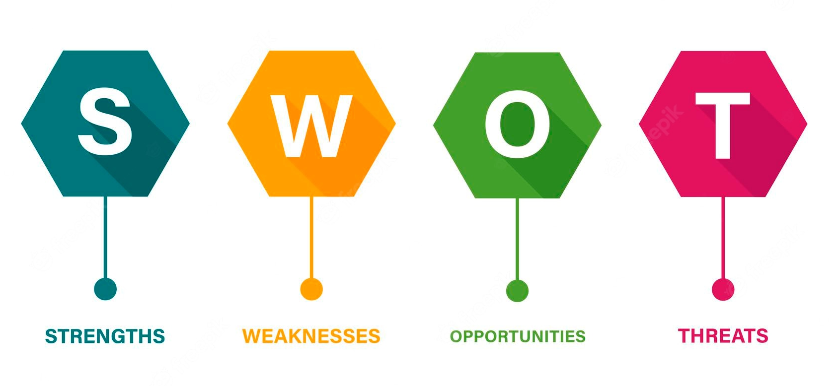
CRITICAL ANALYSIS - SWOT
POSITIVES
Strengths
»Strong team cooperation and help
»Flexibility
»Code integrity (commits)
»Background knowledge in HTML/CSS
Opportunities
»Acquired knowledge
»Further testing to improve application stability
»Deployment of application to remote environments
NEGATIVES
Weaknesses
»Technical knowledge acquisition
»Lack of resources
Threats
»Time constraints
»Mocking mechanisms implementation
»Personalization of delivered application (hardcoded demo data)

Slide 13
DEMONSTRATION
2

Slide 14
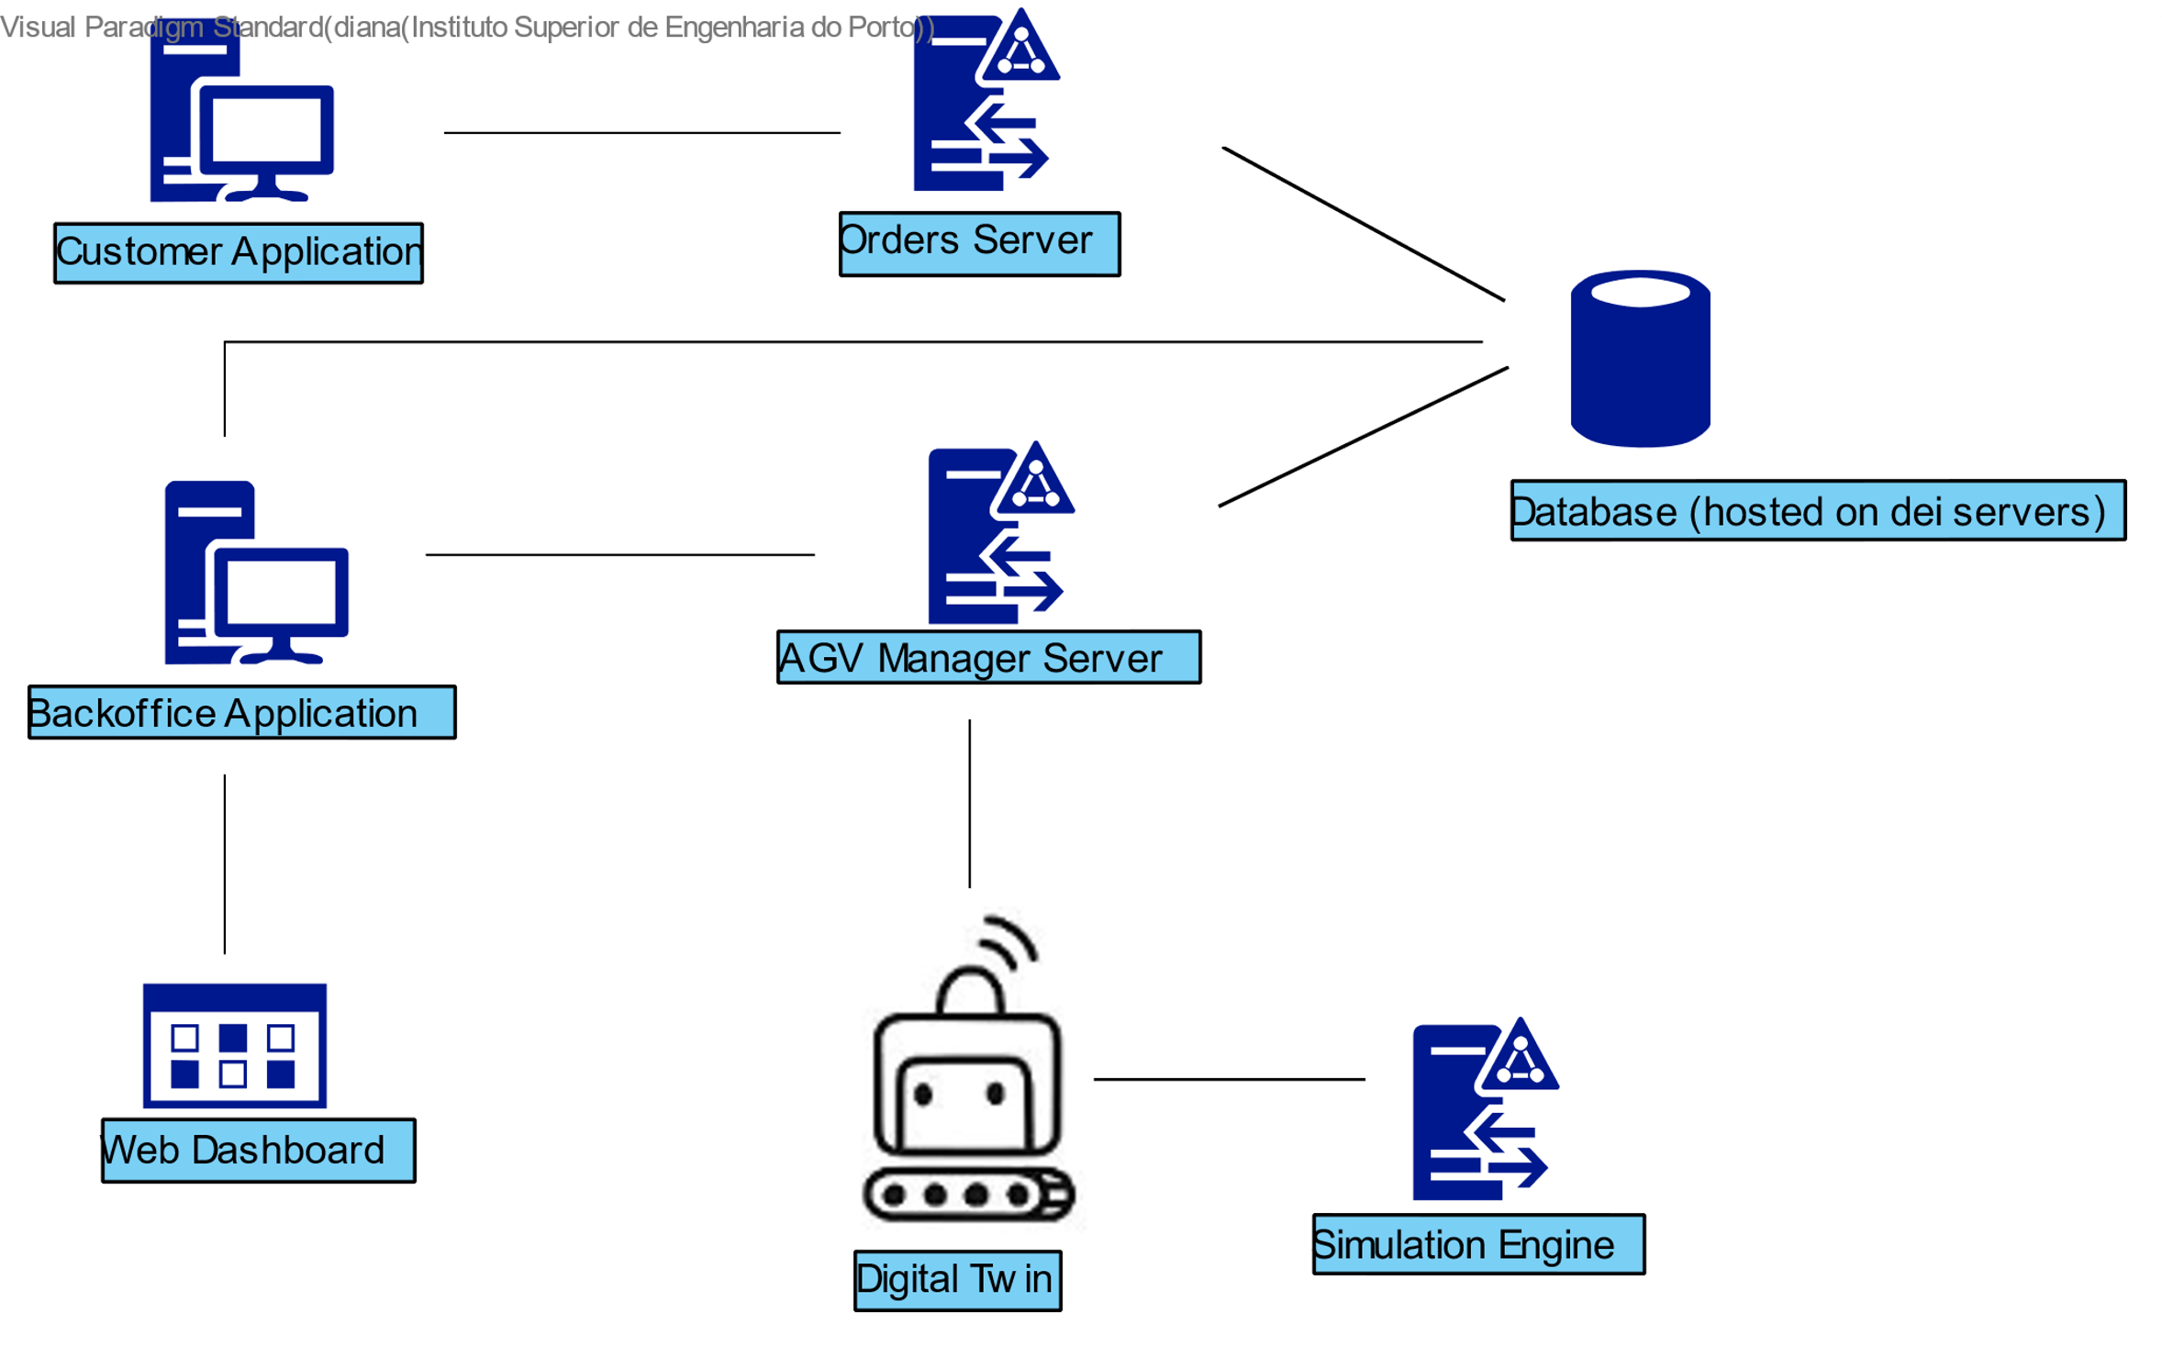
DEPLOYMENT SCENARIO OF SOLUTION
- Deployment scenario of solution
- Evidence of aplying software engineering
- Suggestions of improvement
» Command line deployment (.bat/.sh files)
» C and Java applications
» Web dashboard
Notes:
f

Slide 15
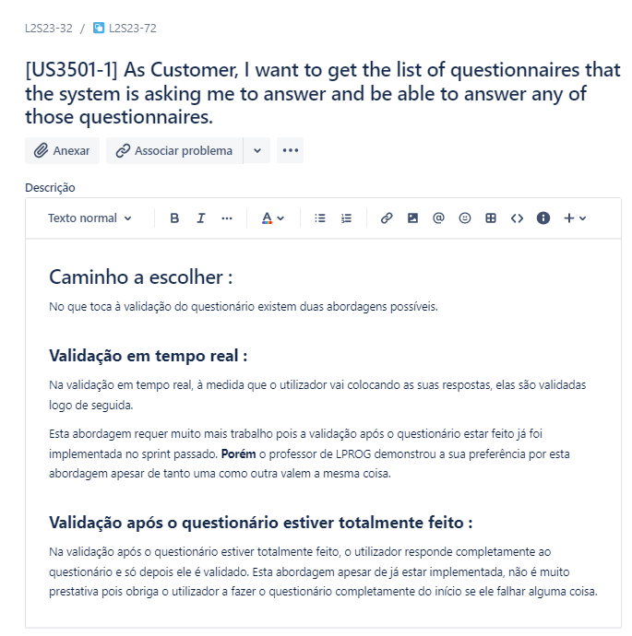
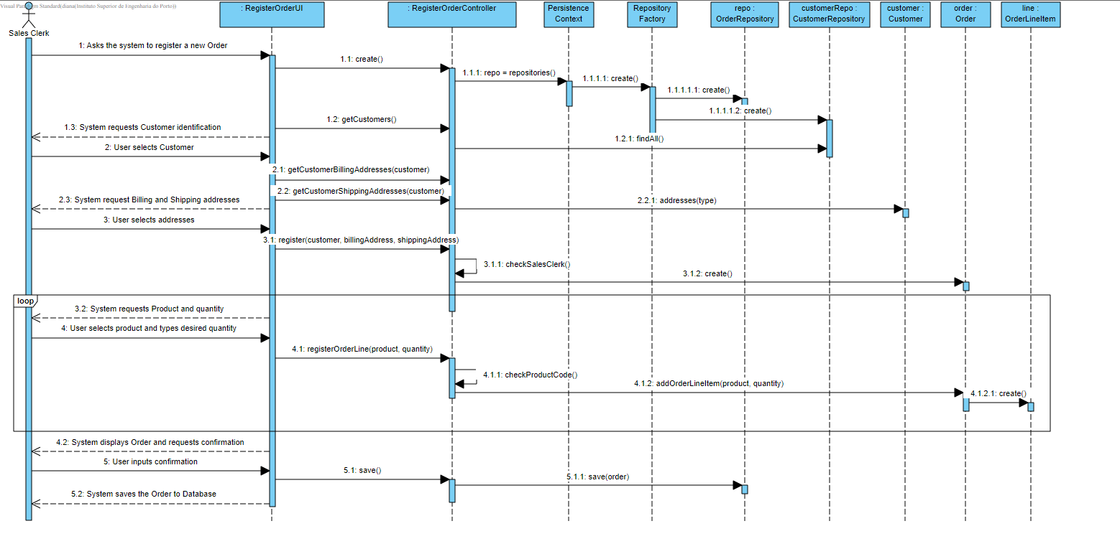
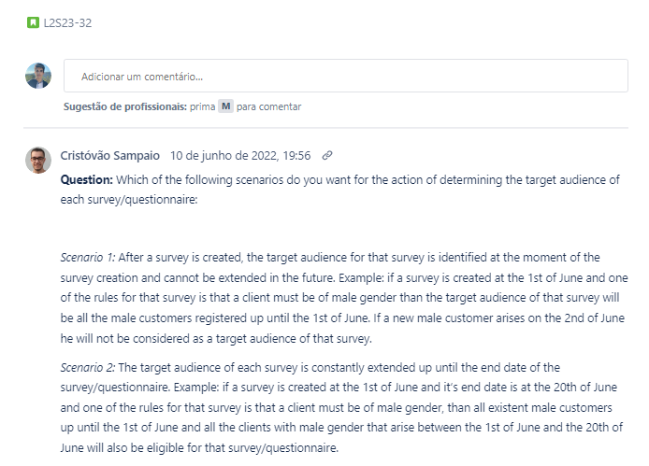
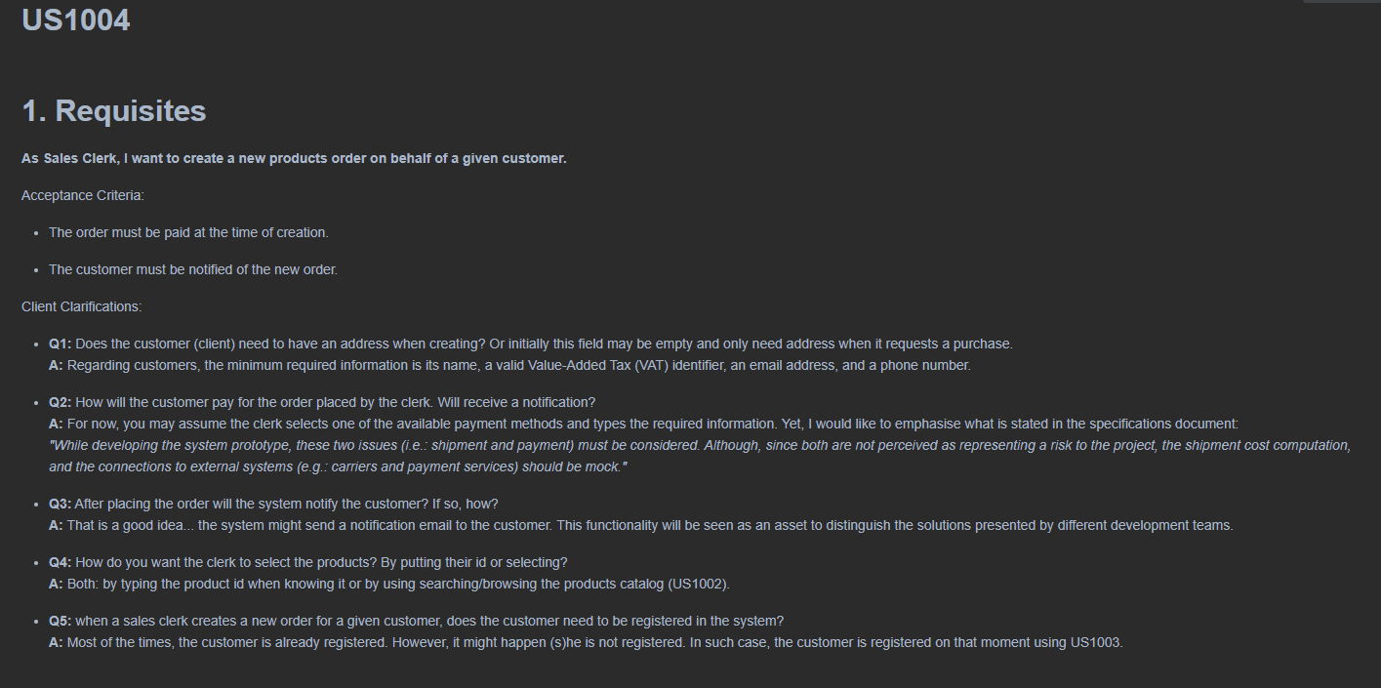
EVIDENCE OF SOFTWARE ENGINEERING

Slide 16



SUGGESTIONS OF IMPROVEMENT
TEAM IMPROVEMENTS
» Better time management
​» Early start to sprint development
» Closer follow-up of tasks on Jira
» Avoid burnout
» Technical research and practice prior to
development
APPLICATION IMPROVEMENTS
» Dynamic data instead of static bootstraped data (e.g. warehouse plant)
» Sturdier digital twin build (lack of development time)
» More testing and documentation

Slide 17
LEI 21-22 S4 2DC_3​
PROGRESS – SPRINT C
29 MAY 2022
Bárbara Pinto 1191507 | ​Carlos Dias 1200991​ | Cristóvão Sampaio 1201029 | ​ Miguel Silva 1201045​ | Martim Maciel 1201154

